Slide 1
Lexicalization Biases in Verb Meanings
(Manner Path Priming)
Anna Serrichio
Snedeker Lab
LDS Summer 2016 Internship
Mentor: Melissa Kline

Slide 2

Background
Method
Results
Discussion
Notes:
The point of this example is to illustrate that you can distinguish the action of a movement from its effect. In this case, “tipping over” would be the effect and “poking” would be the action.

Slide 3
Early conceptual development of action and effect
Background
Method
Results
Discussion
Infants as young as 14 months old can distinguish between action and outcome when watching others perform a task (Gergely, Bekkering & Király, 2002)

Slide 4
Conceptual mapping onto semantic categories
Background
Method
Results
Discussion
Verb framed languages
Most verbs encode manner
Path is often encoded in the prepositional phrase
Example: English
“She ran out of the room”.
Satellite framed languages
Most verbs encode path
Manner is often encoded in the prepositional phrase
Example: Spanish
“Ella salió del cuarto corriendo”.
verb phrase
(manner)
prepositional phrase
(path)
verb phrase
(path)
prepositional phrase
(manner)
Notes:
The way that language encodes these two concepts varies across languages.

Slide 5
Lexicalization biases and semantic reorganization
Background
Method
Results
Discussion
Speech-perception metaphor: Presence of lexicalization biases based on manner and path
These biases can be altered with experience.
For example, if children are exposed to many novel verbs that encode path, they develop an effect bias and predict future new words will also encode path (Havasi, Shafto & Snedeker, 2013)
Some evidence that adults can map manner/path onto action/effect (Geojo, 2014)
Notes:
In the same way children learn which phonemic contrasts are relevant to their native language and show preferential processing of these contrasts, people have biases about whether verbs are likely to encode manner or path depending on their native language.

Slide 6
Questions of interest
Background
Method
Results
Discussion
How flexible are lexicalization biases?
Can they be reorganized semantically? Can young children learn to predict whether novel verbs are likely to encode action or effect based on evidence they encounter?
2. How abstract is this semantic reorganization?
Does prediction of action verbs map on to manner and does the prediction of effect verbs map on to path?
Action
Manner
Action
Manner
Effect
Path
Effect
Path

Slide 7

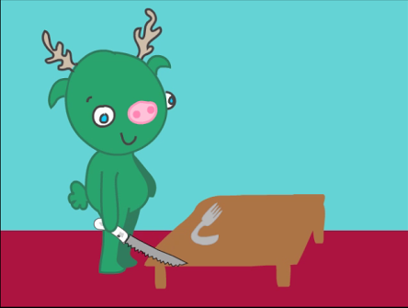
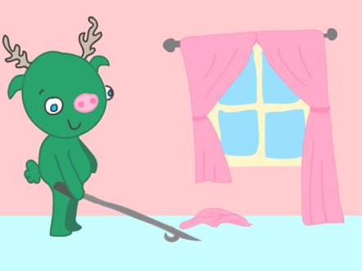
Stimuli
Background
Method
Results
Discussion
Action/Effect
“The monster is going to blick the bread.”
“Which one is blicking?”

Slide 8
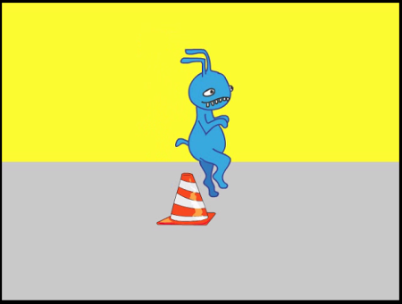
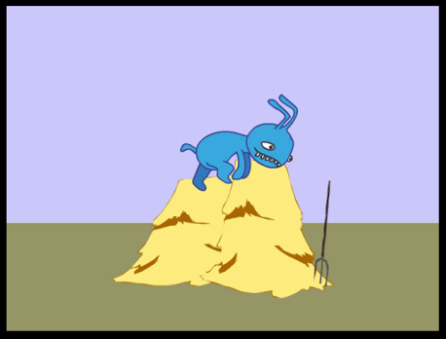
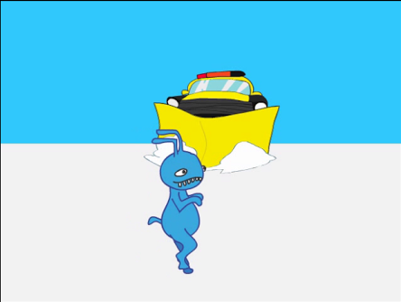
Stimuli
Background
Method
Results
Discussion
Manner/Path
“The monster is going to burk over the cone.”
“Which one is burking?”

Slide 9
Design
Background
Method
Results
Discussion
Participants: 58 four- and five- year old English speaking children
Base phase:
Action condition – saw verbs that encoded action OR
Effect condition – saw verbs that encoded effect
Tested to see if providing evidence action or effect would lead participants to predict future verbs also encode action or effect depending on the condition
Extension phase:
Without prior evidence, participants were tested on whether they predicted novel verbs encoded manner or path

Slide 10
Design
Background
Method
Results
Discussion
Bias Test
Bias Test
Base phase: 8 action-effect trials with evidence for action or effect
Extension phase: 8 manner-path test trials
Evidence
Hammer
Comb
Poker
Baseball Bat
Flattening
Ripping
Crushing
Tipping over
Action
Effect
Test Trial

Slide 11
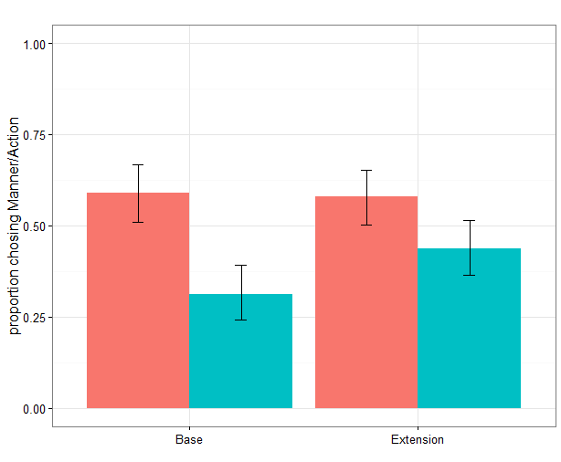


Evidence for action or effect affects predictions of verb meanings
Background
Method
Results
Discussion
*
*
Base
p < 0.006
Extension
p < 0.039
Proportion choosing action/manner
Condition
Action
Effect
Base
Extension

Slide 12
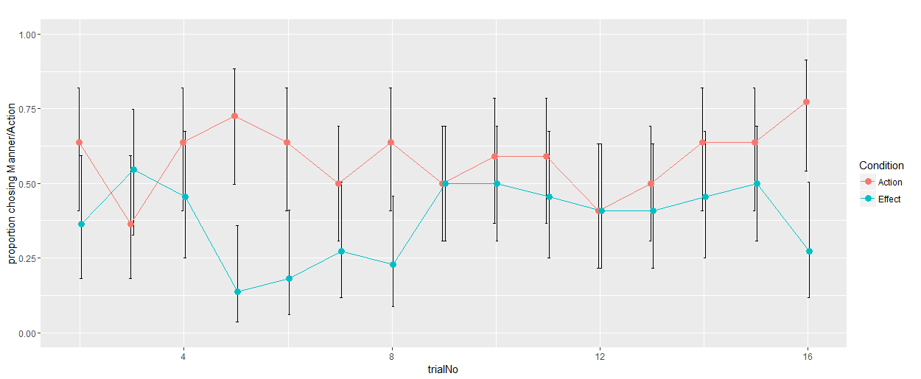
Strength of bias increases with trials
Background
Method
Results
Discussion
Proportion choosing action/manner
BASE (Action/Effect)
EXTENSION (Manner/Path)

Slide 13
Conclusions
Background
Method
Results
Discussion
1. How flexible are lexicalization biases?
Lexicalization biases are flexible and can be updated on the basis of experience. They are sensitive other features of input and are updated as new words are encountered.
2. How abstract is this semantic reorganization?
Lexicalization biases are abstract and reflect underlying conceptual features of words

Slide 14
Conclusions
Background
Method
Results
Discussion
Biases reflect prior linguistic experiences. Consistent with the idea that English is a verb-framed language, participants showed a stronger effect for the mapping of action onto manner than effect onto path.

Slide 15
Future Directions
Background
Method
Results
Discussion
Exploring whether there is a correlation between the strength of biases in the base phase and children’s responses in the extension phase
The next stage of the experiment involves examining whether evidence for manner and path in the base phase can be mapped onto action and effect in the extension phase.
Action
Manner
Effect
Path

Slide 16
Future Directions
Background
Method
Results
Discussion
Running the experiment with Spanish-speaking participants to see if there is a reversal in the strength of action → manner and effect → path bias.
Investigating whether the action/effect and manner/path concepts are consistent with the two-streams hypothesis and whether they depend on cortical regions in the ‘what’ and ‘where’ pathways

